Slide 1
PWA with FDC
yanghx@ihep.ac.cn

Slide 2
Intro
FDC系统根据给出的费曼规则、物理常数等建立物理模型，对所研究的每个可能的物理过程产生对应的费曼图。在对费曼图计算的基础上，产生各个振幅的表达式，并计算出所有过程的总振幅的平方，构造斯然函数，生成相应的拟合程序
自动化计算避免人工计算的繁琐复杂的工作程序，避免人工输入的不必要的失误，节省大量的工作时间
经过与通常分波分析方法的对比检验证明可靠

Slide 3
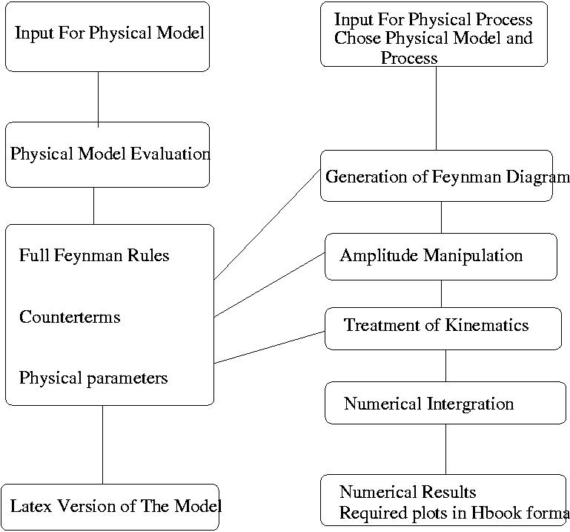
系统结构

Slide 4
准备
Add text to your .tchs file :
source /besfs/users/jixb/fdc.setting
建立分波分析目录
mkidr your_fdcdir
cd your_fdcdir

Slide 5
模型的建立 复制文件
>model_cp /besfs/groups/jpsi/jpsigroup/user/maym/your_fdcdir/your_model your_model
从已有的模型复制所需的文件
Model.def 模型的目录、名称…（需修改）
Model_input对模型的定义：规范场、物质场、CKM矩阵…
Add_vertices 粒子态的定义（可以修改）
Physical_parameters
Symbole_list
cp /besfs/groups/jpsi/jpsigroup/user/maym/your_fdcdir/your_model/psfig.sty to your model

Slide 6
Edit model.def
Change to your model directory
% Please revise the following items when a new model is created.
model_home:='"/d07/yanghx/fdc/fdctest/model/";
model_name:='"SM and Some Phenomenology Lagrangian";
model_author:='"Y.Y. Young";
model_time:='"Mar 3th, 2004";
% The following three files must be prepared by USER and are placed
% in directory "model_home".
model_input:='model_input$ % description of the physical model.
symbole_list:='symbole_list$ % something needed for drawing diagram.
physical_parameters:='physical_parameters$ % physical parameters input.
;end;

Slide 7
Edit add_vertices
pa_list_add:={
% name spin parity c isospin G Strange Baryon Charge Mass Widh
{"J/\psi", 1, -1, -1, 0, -1, 0, 0, 0, 3.09688, 0.000087},
{"P", 1/2, +1, X, 1/2, X, 0, 1, 1, 0.938272, 0},
{"\pi", 0, -1, X, 1, -1, 0, 0, 1, 0.13957, 0},
{"k", 0, -1, X, 1/2, X, 1, 0, 1, 0.493677, 0},
{"\Lambda", 1/2, +1, X, 0, X, -1, 1, 0, 1.1158, 0},
{"N[1535-]", 1/2, -1, X, 1/2, X, 0, 1, 1, 1.650, 0.10},
{"N[1650-]", 1/2, -1, X, 1/2, X, 0, 1, 1, 1.650, 0.10},
%{"N[1650+]", 1/2, +1, X, 1/2, X, 0, 1, 1, 1.650, 0.150},
{"N[1710+]", 1/2, +1, X, 1/2, X, 0, 1, 1, 1.710, 0.10},
{"N[1720+]", 3/2, +1, X, 1/2, X, 0, 1, 1, 1.720, 0.150},
{"N[1900+]", 3/2, +1, X, 1/2, X, 0, 1, 1, 1.900, 0.300},
{"N[20503]", 3/2, +1, X, 1/2, X, 0, 1, 1, 2.050, 0.200},
{"\Lambda[1405-]", 1/2, -1, X, 0, X, -1, 1, 0, 1.5065, 0.05},
{"\Lambda[1520-]", 3/2, -1, X, 0, X, -1, 1, 0, 1.5195, 0.0156},
{"\Lambda[1600+]", 1/2, +1, X, 0, X, -1, 1, 0, 1.600, 0.150},
{"\Lambda[1670-]", 1/2, -1, X, 0, X, -1, 1, 0, 1.670, 0.035},
{"\Lambda[1690-]", 3/2, -1, X, 0, X, -1, 1, 0, 1.690, 0.060},
{"\Lambda[1800-]", 1/2, -1, X, 0, X, -1, 1, 0, 1.8, 0.3},
{"\Lambda[1810+]", 1/2, +1, X, 0, X, -1, 1, 0, 1.810, 0.15},
{"\Lambda[1890+]", 3/2, +1, X, 0, X, -1, 1, 0, 1.890, 0.1},
{"k_2[2075]", 1, -1, X, 1/2, X, 1, 0, 1, 2.075, 0.090}
};
phase_method:='phase_resonace;
phase_method:='real_coefficient;
%final_particle_list:={"p","\pi","k","eta"}
vertices_add_comment:='"In this model, We have added some effective
vertices, to do some calculation related to some resonance states";
end;
参与拟合的态
自己增减

Slide 8
模型的构造 构造
>cd your_model 进入模型目录
>rm model_state 描述gmodel* 命令的返回值
>gmodel1根据物理模型，产生物质场相互作用model_state
>gmodel2 产生模型的Lagrangian函数并量子化model_state
>gmodel3费曼规则的建华处理 查：model_state
>glmodel产生模型的Latex 文件 查：out
>lamodel 产生模型的ps文件等 查：out

Slide 9
物理过程
建立过程目录（在FDC目录下:your_fdc）
>process_cp /besfs/groups/jpsi/jpsigroup/user/maym/your_fdcdir/your_process your_process
>cd your_process
>edit(vi) process.def
>diag 产生费曼图
>amp 产生振幅
>kine 动力学过程
>cd fort FDC产生的分波分析目录
>make 生成可执行文件用于拟合

Slide 10
构造模型
>rm -f model_state //删除status文件
> gmodel1
> more model_state //检查status文件
generator_1:='ok$
> gmodel2
< more model_state
generator_2:='ok$
$
;end;
$
> gmodel3
> more model_state
generator_1:='ok$$
generator_2:='ok$$
generator_3:='ok$$
;end;$
>glmodel
> tail out
end;
12:
* ......The latex file model.tex was generated
* Please latex it
13:
Time: 100 ms
14:
Quitting
>lamodel //生成ps文件

Slide 11
Edit process.def
Please revise the following items when a new process is created.
algebraic;
model_home:='"/d07/yanghx/fdc/fdctest/model/";
process_name:='"jpsi --->p k- Lambda_bar, tree";
process_author:='"Y.Y. Young";
process_time:='"Mar. 3th, 2004";
namel:='(ef efb pr2 pr5b pr4b)$
inpl:='(1 1 -1 -1 -1)$
ncolor:='1$
n_bound_state:='1;
change_parameters:='(
);
input_list:='(
(ec 3.09) %center mass energy
(hm 120.0) %the parameters could be changed in this way
(acc1 0.01) %acurcy of grid optimization in bases
(acc2 0.01) %acurcy of integration in bases
(itmx1 10) %number of iteration for grid optimization
(itmx2 10) %number of iteration for integration
(ncall 10000) %number of sample point in each iteration.
(mxdim 50) %number of maxium integration dimension.
(akapa 1.0)
(mc_num 69692)
(da_num 5433)
(iter 1000)
);
%approximation_rules:={fme=>0,f73=>0,f74=>0};
mass_drop_list:='((fme 0));
histograms:={
{1,wcos(p3,z),50,"cos(p,beam) "},
{3,sqrts(p3,p5),50,"M(p K^-!)"},
{4,sqrts(p4,p5),50,"M(K^-! [l]^&-!)"},
{5,sqrts(p3,p4),50,"M(lambda and p)"}
};
scatters:={
{1,s(p4,p5),s(p3,p5),30,30,2.5,4.5,2.0,4.0,"Daliz plot"}
};
mkfit:='yes;
end;
Change to your model directory
e+e-→pkL
初末态粒子列表。根据过程自己修改
粒子名称定义见model目录里的model.ps
拟合用到的蒙特卡罗和data数据事例数
拟合产生的图的定义

Slide 12
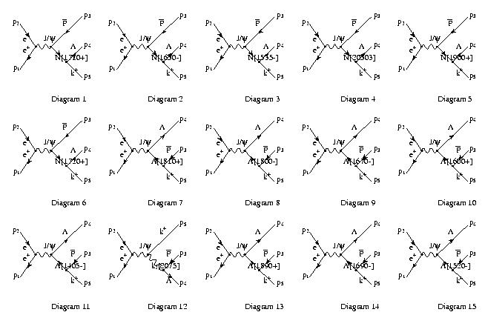
物理过程
> diag
There are 1 diagram pages
> tail out
There are 15 diagrams for this order,
The next step is to evaluate the amplitude by performing
amplitude_evaluation()
The next step is to generate kinematics by performing
generation_kinematics()
Time: 10 ms
5:
Quitting
> gv diagram/diag.ps &
[1] 31649
> amp
> tail out
color factor for diagram 13
color factor for diagram 14
color factor for diagram 15
Time: 230 ms
n_background==1
zero_list:=(14)
Time: 120 ms
5:
Quitting
> kine
> tail out
sn=s-p15m^2
sn=s-p16m^2
sn=s-p17m^2
sn=s-p18m^2
sn=s-p19m^2
Time: 180 ms
5:
Quitting
>
检查out文件看每一步操作是否成功。若out文件最后显示时间，则成功（WJX）语
查看生成的diag.ps

Slide 13
拟合
修改flag.inp文件
修改fpara.inp文件
建立实验数据文件 pdata1.dat
>cp /bespcfarm0/d07/yanghx/fdc/nxcor/dat/pklkp.dat.dat5421 pdata1.dat
建立MC数据文件 pdata1.mc
>cp /bespcfarm0/d07/yanghx/fdc/nxcor/dat/pklkp.dat.mcv403.89133 pdata1.mc
>./fit MC积分
修改flag.inp
>fit 拟合
Fort 目录可以改名、复制到其他机器上运行（不依赖于FDC环境）

Slide 14
需要修改的文件
Flag.inp
做MC积分的状态
'ITER=' 2000
'PLOT=' 1
'do_mc=' 'y'
'MC_num=' 69692
'da_num=' 5433
'kfdc_num=' 0
Flag.inp
做数据拟合的状态
'ITER=' 1000
'PLOT=' 2
'do_mc=' 'n'
'MC_num=' 69692
'da_num=' 5433
'kfdc_num=' 0

Slide 15
修改fpara.inp
103
1 0 -0.1 0 1000 % backg is the constant background
2 0 -0.1 -10 10 % real(f31) in diagram
3 0 -0.1 -10 10 % image(f31) in diag 1 of mode 1
4 0 -0.1 -10 10 % real(f32) in diagram
5 0 -0.1 -10 10 % image(f32) in diag 1 of mode 1
6 0 -0.1 -10 10 % real(f9) in diagram
7 0 -0.1 -10 10 % image(f9) in diag 1 of mode 1
8 0 -0.1 -10 10 % real(f33) in diagram
9 0 -0.1 -10 10 % image(f33) in diag 2 of mode 2
10 0 -0.1 -10 10 % real(f34) in diagram
11 0 -0.1 -10 10 % image(f34) in diag 2 of mode 2
12 0 -0.1 -10 10 % real(f10) in diagram
13 0 -0.1 -10 10 % image(f10) in diag 2 of mode 2
.
.
.
96 0 -0.1 -10 10 % real(f54) in diagram
97 0 -0.1 -10 10 % image(f54) in diag 15 of mode 15
98 0 -0.1 -10 10 % real(f55) in diagram
99 0 -0.1 -10 10 % image(f55) in diag 15 of mode 15
100 0 -0.1 -10 10 % real(f56) in diagram
101 0 -0.1 -10 10 % image(f56) in diag 15 of mode 15
102 0 -0.1 -10 10 % real(f14) in diagram
103 0 -0.1 -10 10 % image(f14) in diag 15 of mode 15
Comment: The parameters f1 are fixed to 1.0 in the parameter.f or here
103
1 0 - 0.1 0 1000 % backg is the constant background
2 1.0 0.1 -10 10 % real(f31) in diagram
3 1.0 0.1 -10 10 % image(f31) in diag 1 of mode 1
4 1.0 0.1 -10 10 % real(f32) in diagram
5 1.0 0.1 -10 10 % image(f32) in diag 1 of mode 1
6 1.0 -0.1 -10 10 % real(f9) in diagram
7 0.0 -0.1 -10 10 % image(f9) in diag 1 of mode 1
8 1.0 0.1 -10 10 % real(f33) in diagram
9 1.0 0.1 -10 10 % image(f33) in diag 2 of mode 2
10 1.0 0.1 -10 10 % real(f34) in diagram
11 1.0 0.1 -10 10 % image(f34) in diag 2 of mode 2
12 1.0 -0.1 -10 10 % real(f10) in diagram
13 0.0 -0.1 -10 10 % image(f10) in diag 2 of mode 2
.
.
.
96 1.0 0.1 -10 10 % real(f54) in diagram
97 1.0 0.1 -10 10 % image(f54) in diag 15 of mode 15
98 1.0 0.1 -10 10 % real(f55) in diagram
99 1.0 0.1 -10 10 % image(f55) in diag 15 of mode 15
100 1.0 0.1 -10 10 % real(f56) in diagram
101 1.0 0.1 -10 10 % image(f56) in diag 15 of mode 15
102 1.0 -0.1 -10 10 % real(f14) in diagram
103 0.0 -0.1 -10 10 % image(f14) in diag 15 of mode 15
Comment: The parameters f1 are fixed to 1.0 in the parameter.f or here

Slide 16
MC积分和对数据的拟合
[yanghx@bespcfarm13 fort]$ fit
n= 15
n= 15
namp= 1 1 1 1 1 1 1 1 1 1 1 1 1 1 1
You have processed 600 MC DATA events
You have processed 500 Experiment DATA events
data prepare ok
function minimisation by subroutine fumili/likelm,in the following print-out s = value of objective function, ec = expected change in s during next iteration, kappa = estimated distance to minimum, lambda = step length modifier
warning: minimum equal to 0. for parametr 1
1iteration no. 0, s= 0.29632E+02, ec = -0.76663E-01, kappa= 0.22892E+01, lambda= 0.21809E-03
1iteration no. 1, s= 0.29558E+02, ec = -0.32248E-02, kappa= 0.18568E+01, lambda= 0.15914E-04
0minimisation terminated as iteration limit reached
1
The likelyhood function= 29.5578728
The Chi**2 function= 0.
nr= 16
np= 103
[yanghx@bespcfarm13 fort]$ fit
n= 15
n= 15
namp= 1 1 1 1 1 1 1 1 1 1 1 1 1 1 1
data prepare ok
function minimisation by subroutine fumili/likelm,in the following print-out s = value of objective function, ec = expected change in s during next iteration, kappa = estimated distance to minimum, lambda = step length modifier
warning: minimum equal to 0. for parametr 1
1iteration no. 0, s= 0.29632E+02, ec = -0.76663E-01, kappa= 0.22892E+01, lambda= 0.21809E-03
1iteration no. 1, s= 0.29558E+02, ec = -0.32248E-02, kappa= 0.18568E+01, lambda= 0.15914E-04
1iteration no. 2, s= 0.29555E+02, ec = -0.71582E-02, kappa= 0.18650E+01, lambda= 0.33162E-04
1iteration no. 3, s= 0.29547E+02, ec = -0.16898E-01, kappa= 0.21245E+01, lambda= 0.79446E-04
0minimisation terminated as iteration limit reached
1
The likelyhood function= 29.5474606
The Chi**2 function= 0.
nr= 16
np= 103
修改flag.inp

Slide 17
拟合结果的检查
S值
mplot.info
显示各态的百分比和相互干涉
dplot.hbook
Histogram 1-5 数据的各分部
Histogram 6-10 相空间的各分部
mplot.hbook
Histogram 1-5 拟合结果的总分部
Histogram 11-… 各中间态的分布
the lines 1,..., 5 is in mode 0
the lines 6,..., 10 is in mode -1
the lines 11,..., 15 is in mode 1
the lines 16,..., 20 is in mode 2
.
.
.
the lines 81,..., 85 is in mode 15
Sigma= 0.83335183 total cross section
br= 0.00000000 constant background
br= 0.00899441 mode 1 with diag 1
br= 0.07083086 mode 2 with diag 2
.
.
.
br= -0.00000533 int of mode 14 and 15

Slide 18
改变质量和宽度reson.inp
16
1 3.09688 8.7e-05 % Resonace J/\psi in diagram 1
2 1.72 0.15 % Resonace N[1720+] in diagram 6
3 1.9 0.3 % Resonace N[1900+] in diagram 5
4 2.05 0.2 % Resonace N[20503] in diagram 4
5 1.65 0.1 % Resonace N[1535-] in diagram 3
6 1.65 0.1 % Resonace N[1650-] in diagram 2
7 1.71 0.1 % Resonace N[1710+] in diagram 1
8 1.5195 0.0156 % Resonace \Lambda[1520-] in diagram 15
9 1.69 0.06 % Resonace \Lambda[1690-] in diagram 14
10 1.89 0.1 % Resonace \Lambda[1890+] in diagram 13
11 1.5065 0.05 % Resonace \Lambda[1405-] in diagram 11
12 1.6 0.15 % Resonace \Lambda[1600+] in diagram 10
13 1.67 0.035 % Resonace \Lambda[1670-] in diagram 9
14 1.8 0.3 % Resonace \Lambda[1800-] in diagram 8
15 1.81 0.15 % Resonace \Lambda[1810+] in diagram 7
16 2.075 0.09 % Resonace k_2[2075] in diagram 12
改变质量和宽度后要重新做MC积分

Slide 19
注释掉某些态不参与拟合 amptable.inp
'n_tot=' 15 total number of diagram in the process
'n_cal=' 15 number of diagram to be calculated
'comment' m n m-th diagram, n=1 means keep, 0 means drop
1 1
2 1
3 1
4 1
5 1
6 1
7 1
8 1
9 1
10 1
11 1
12 1
13 1
14 1
15 1
1表示参与拟合。0表示不参与拟合

